Slide 1
Echelon Forms and Row Reduction
Linear Algebra
Department of Computer Engineering
Sharif University of Technology
Hamid R. Rabiee rabiee@sharif.edu
Maryam Ramezani maryam.ramezani@sharif.edu

Slide 2
Overview
Row-Reduced Matrix
Echelon form
Solutions of a Linear System
Row-Reduced Echelon Form

Slide 3
Row-Reduced Matrix

Slide 4
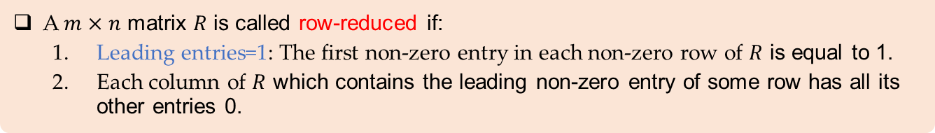
Row-Reduced Matrix
Definition
A leading entry of a row refers to the leftmost nonzero entry in a nonzero row.
Definition
A $m×n$ matrix $R$ is called row-reduced if:
Leading entries=1: The first non-zero entry in each non-zero row of $R$ is equal to 1.
Each column of $R$ which contains the leading non-zero entry of some row has all its other entries 0.

Slide 5
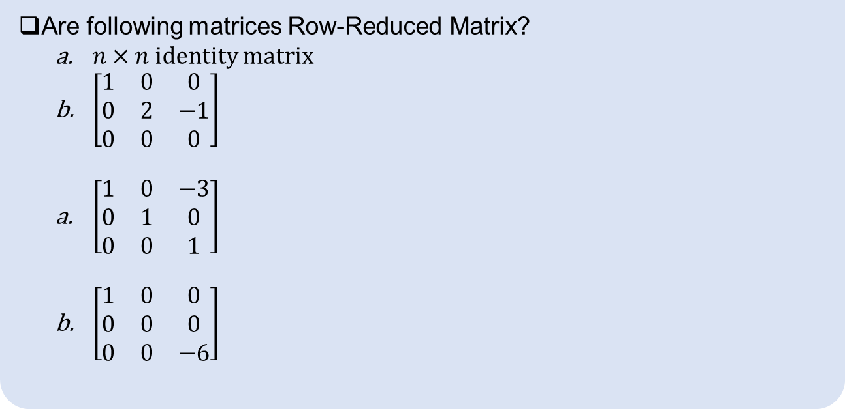
Row-Reduced Matrix
Example
Are following matrices Row-Reduced Matrix?
$n×n$ identity matrix
$\left[\begin{matrix}1 & 0 & 0 \\ 0 & 2 & −1 \\ 0 & 0 & 0\end{matrix}\right]$
$\left[\begin{matrix}1 & 0 & −3 \\ 0 & 1 & 0 \\ 0 & 0 & 1\end{matrix}\right]$
$\left[\begin{matrix}1 & 0 & 0 \\ 0 & 0 & 0 \\ 0 & 0 & −6\end{matrix}\right]$

Slide 6
Row-Reduced matrix for Every Matrix
Theorem
Every $m×n$ matrix over the field $F$ is row-equivalent to a row-reduced matrix.

Slide 7
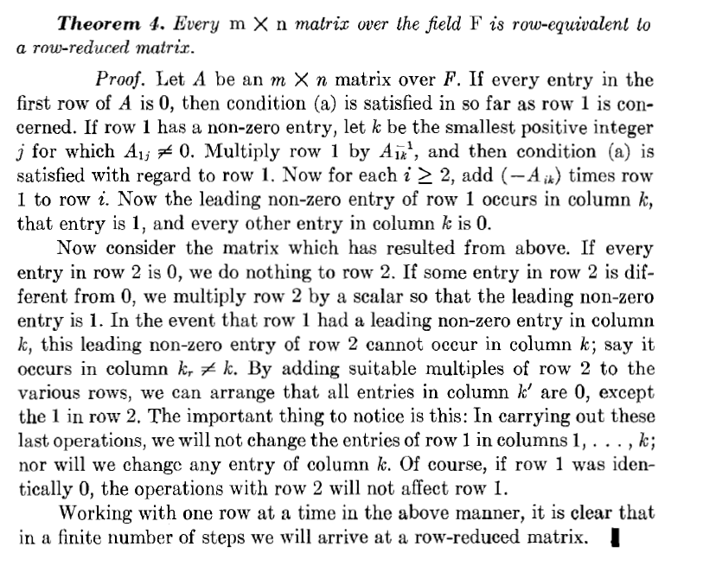
Row-Reduced matrix for Every Matrix
Theorem
For

Slide 8
Echelon Form

Slide 9
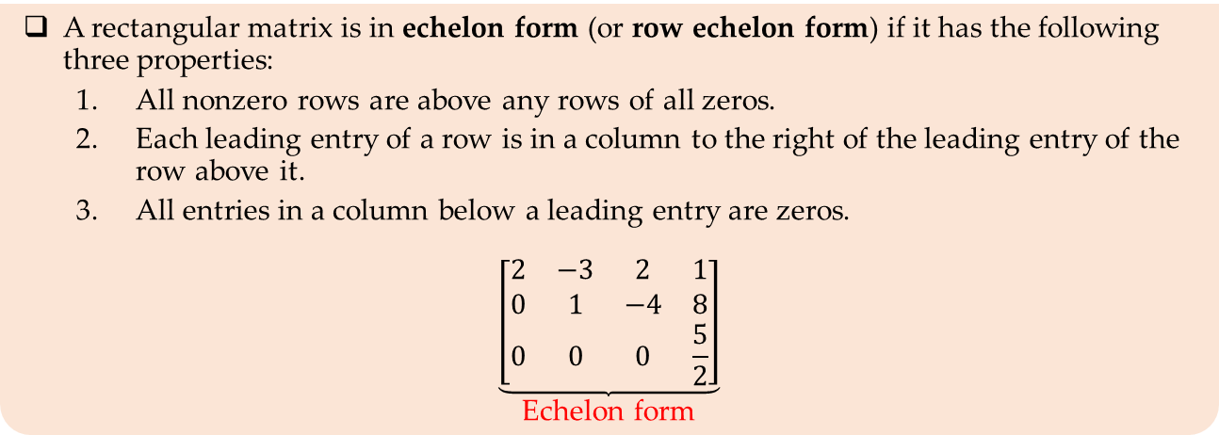
Echelon form
Definition
A rectangular matrix is in echelon form (or row echelon form) if it has the following three properties:
All nonzero rows are above any rows of all zeros.
Each leading entry of a row is in a column to the right of the leading entry of the row above it.
All entries in a column below a leading entry are zeros.
$$\underset{\text{Echelon} \text{form}}{\underbrace{\left[\begin{matrix}2 & −3 & 2 & 1 \\ 0 & 1 & −4 & 8 \\ 0 & 0 & 0 & \frac{5}{2}\end{matrix}\right]}}$$

Slide 10
Row-Reduced Echelon Form

Slide 11
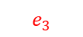
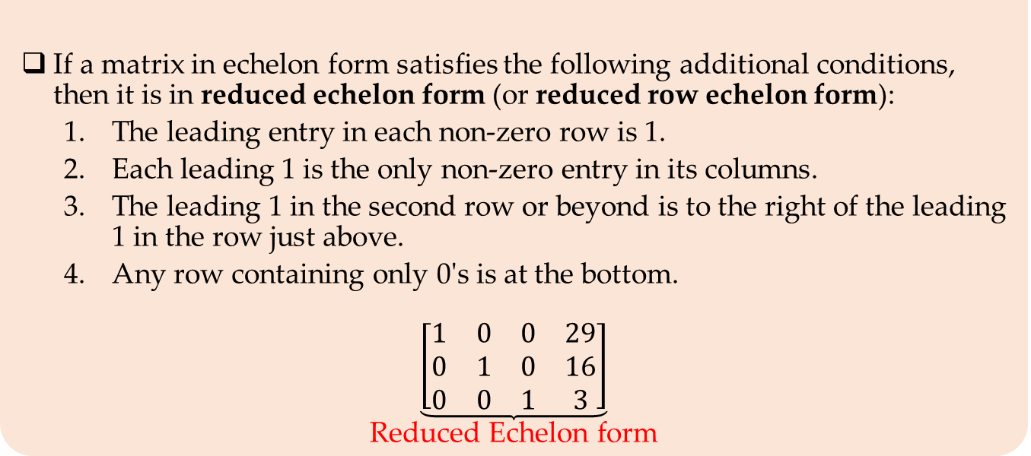
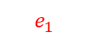
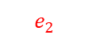
Row-Reduced Echelon Form (RREF)
Definition
If a matrix in echelon form satisfies the following additional conditions, then it is in reduced echelon form (or reduced row echelon form):
The leading entry in each non-zero row is 1.
Each leading 1 is the only non-zero entry in its columns.
The leading 1 in the second row or beyond is to the right of the leading 1 in the row just above.
Any row containing only 0's is at the bottom.
$$\underset{\text{Reduced} \text{Echelon} \text{form}}{\underbrace{\left[\begin{matrix}1 & 0 & 0 & 29 \\ 0 & 1 & 0 & 16 \\ 0 & 0 & 1 & 3\end{matrix}\right]}}$$
$$e_{1}$$
$$e_{3}$$
$$e_{2}$$

Slide 12
Row-Reduced echelon matrix for Every Matrix
Theorem
Every $m×n$ matrix over the field $F$ is row-equivalent to a row-reduced echelon matrix.

Slide 13
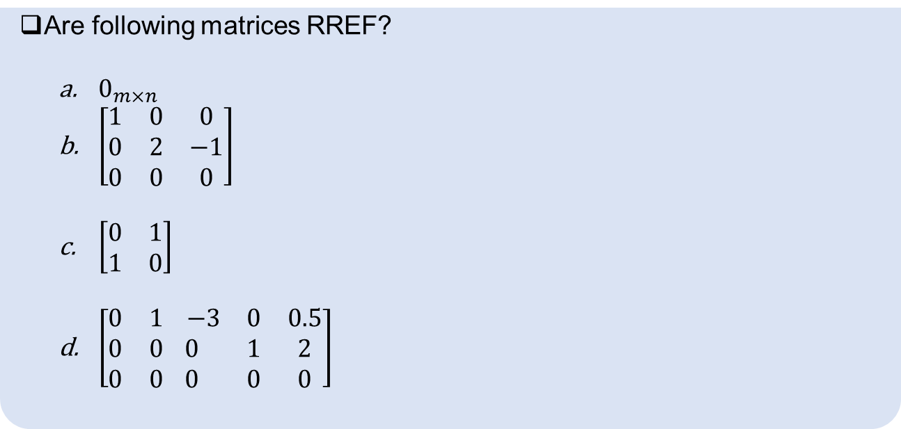
Reduced Echelon Form (RREF)
Example
Are following matrices RREF?
$0_{m×n}$
$\left[\begin{matrix}1 & 0 & 0 \\ 0 & 2 & −1 \\ 0 & 0 & 0\end{matrix}\right]$
$\left[\begin{matrix}0 & 1 \\ 1 & 0\end{matrix}\right]$
$\left[\begin{matrix}0 & 1 \\ 0 & 0 \\ 0 & 0\end{matrix}\begin{matrix} −3 & 0 & 0.5 \\ 0 & 1 & 2 \\ 0 & 0 & 0\end{matrix}\right]$
Notes:
https://people.math.carleton.ca/~kcheung/math/notes/MATH1107/wk04/04_reduced_row-echelon_form.html

Slide 14
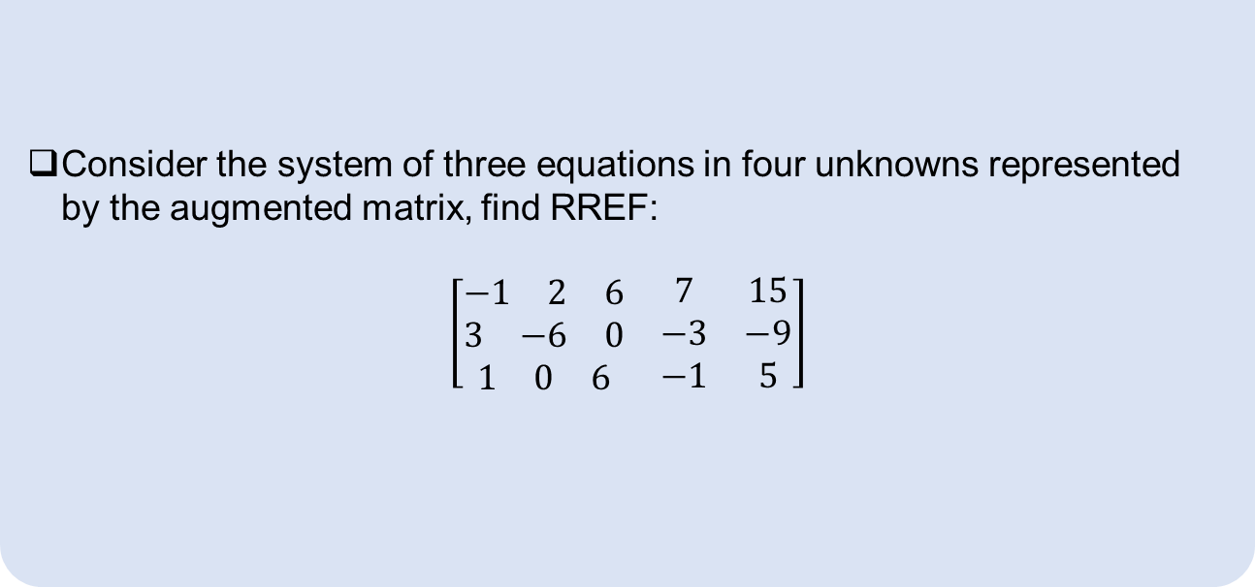
Reduced Echelon Form (RREF)
Example
Consider the system of three equations in four unknowns represented by the augmented matrix, find RREF:
$$\left[\begin{matrix}\begin{matrix}−1 & 2 & 6\end{matrix} & 7 & 15 \\ \begin{matrix}3 & −6 & 0\end{matrix} & −3 & −9 \\ \begin{matrix}1 & 0 & 6\end{matrix} & −1 & 5\end{matrix}\right]$$
Notes:
https://www.statlect.com/matrix-algebra/Gauss-Jordan-elimination

Slide 15
Existence and Uniqueness Questions
Two fundamental questions about a linear system:
Is the system consistent? That is, does at least one solution exist?
If a solution exists, is it the only one? That is, is the solution unique?

Slide 16
Solutions of a Linear System

Slide 17
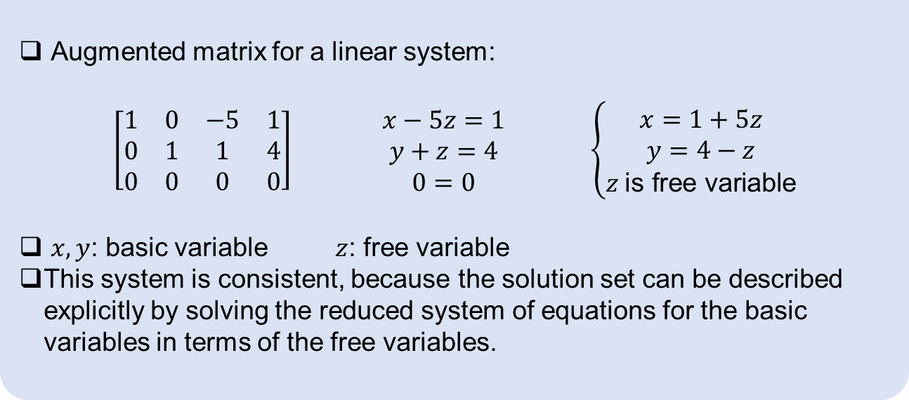
Elementary Row Operations
Example
Augmented matrix for a linear system:
$$\begin{matrix}\left[\begin{matrix}1 & 0 & −5 & 1 \\ 0 & 1 & 1 & 4 \\ 0 & 0 & 0 & 0\end{matrix}\right] & \begin{matrix}x−5z=1 \\ y+z=4 \\ 0=0\end{matrix} & \left\{\begin{aligned}x=1+5z \\ y=4−z \\ z \text{is} \text{free} \text{variable}\end{aligned}\right.\end{matrix}$$
$x,y$: basic variable $z$: free variable
This system is consistent, because the solution set can be described explicitly by solving the reduced system of equations for the basic variables in terms of the free variables.

Slide 18
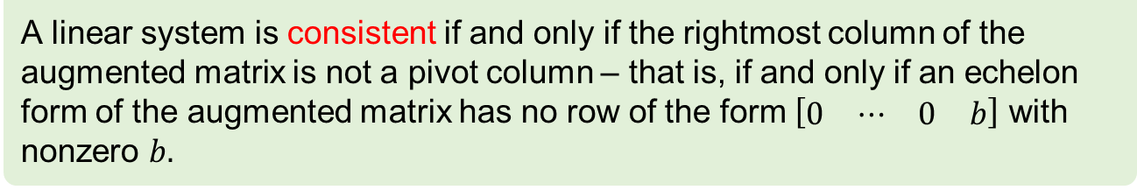
Existence and Uniqueness Questions
Theorem
A linear system is consistent if and only if the rightmost column of the augmented matrix is not a pivot column – that is, if and only if an echelon form of the augmented matrix has no row of the form $\left[\begin{matrix}0 & ⋯ & 0 & b\end{matrix}\right]$ with nonzero $b.$
If a linear system is consistent, then the solution set contains either:
A unique solution, when there are no free variables
Infinitely many solutions, when there is at least one free variable

Slide 19
Find all solutions of a linear system
Write the augmented matrix of the system.
Use the row reduction algorithm to obtain an equivalent augmented matrix in echelon form. Decide whether the system is consistent. If there is no solution, stop; otherwise, go to the next step.
Continue row reduction to obtain the reduced echelon form.
Write the system of equations corresponding to the matrix obtained in step 3.
Rewrite each nonzero equation from step 4 so that its one basic variable is expressed in terms of any free variables appearing in the equation.

Slide 20
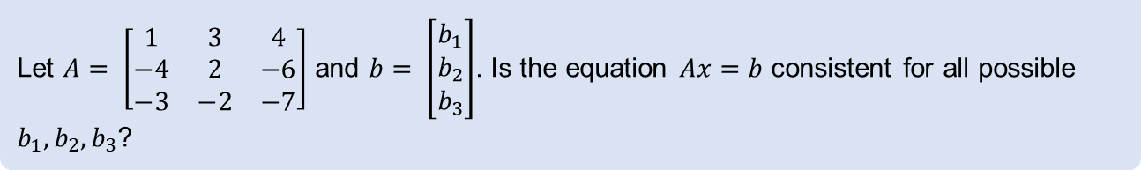
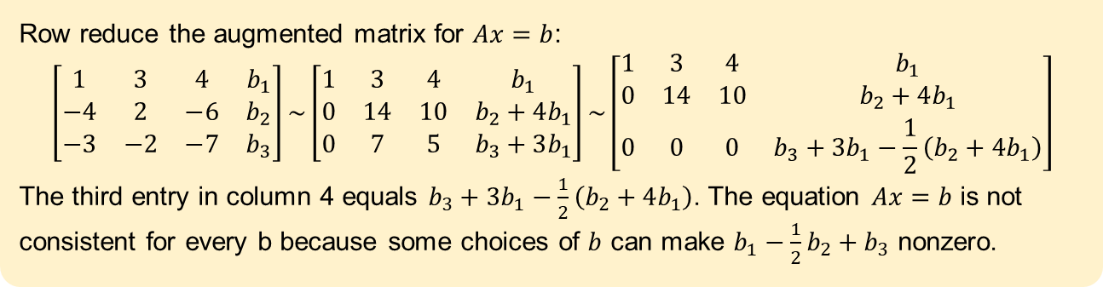
Existence of Solutions
Example
Let $A= \left[\begin{matrix}1 & 3 & 4 \\ −4 & 2 & −6 \\ −3 & −2 & −7\end{matrix}\right]$ and $b= \left[\begin{matrix}b_{1} \\ b_{2} \\ b_{3}\end{matrix}\right]$. Is the equation $Ax=b$ consistent for all possible $b_{1},b_{2},b_{3}$?
Solution
Row reduce the augmented matrix for $Ax=b$:
$$\left[\begin{matrix}1 & 3 & 4 & b_{1} \\ −4 & 2 & −6 & b_{2} \\ −3 & −2 & −7 & b_{3}\end{matrix}\right]\sim \left[\begin{matrix}1 & 3 & 4 & b_{1} \\ 0 & 14 & 10 & b_{2}+4b_{1} \\ 0 & 7 & 5 & b_{3}+3b_{1}\end{matrix}\right]\sim \left[\begin{matrix}1 & 3 & 4 & b_{1} \\ 0 & 14 & 10 & b_{2}+4b_{1} \\ 0 & 0 & 0 & b_{3}+3b_{1}−\frac{1}{2}\left(b_{2}+4b_{1}\right)\end{matrix}\right]$$
The third entry in column 4 equals $b_{3}+3b_{1}−\frac{1}{2}\left(b_{2}+4b_{1}\right)$. The equation $Ax=b$ is not consistent for every b because some choices of $b$ can make $b_{1}−\frac{1}{2}b_{2}+b_{3}$ nonzero.
Notes:
Different color for solution box

Slide 21
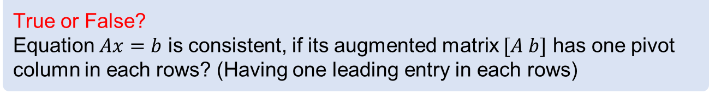
Existence of solutions
Example
True or False?
Equation $Ax=b$ is consistent, if its augmented matrix $[A b]$ has one pivot column in each rows? (Having one leading entry in each rows)

Slide 22
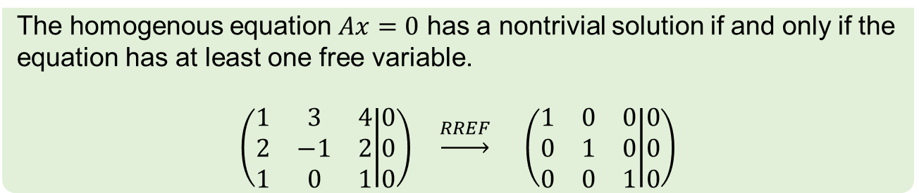
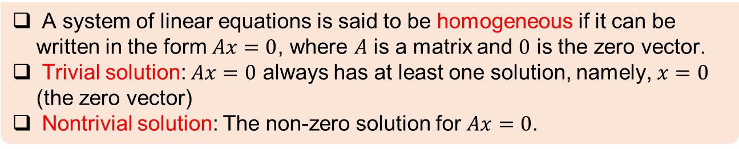
Homogeneous Linear Systems
Definition
A system of linear equations is said to be homogeneous if it can be written in the form $Ax=0$, where $A$ is a matrix and $0$ is the zero vector.
Trivial solution: $Ax=0$ always has at least one solution, namely, $x=0$ (the zero vector)
Nontrivial solution: The non-zero solution for $Ax=0$.
Fact
The homogenous equation $Ax=0$ has a nontrivial solution if and only if the equation has at least one free variable.
$$\left(\begin{matrix}1 & 3 & 4 \\ 2 & −1 & 2 \\ 1 & 0 & 1\end{matrix} | \begin{matrix}0 \\ 0 \\ 0\end{matrix}\right) \underset{→}{RREF} \left(\begin{matrix}1 & 0 & 0 \\ 0 & 1 & 0 \\ 0 & 0 & 1\end{matrix} | \begin{matrix}0 \\ 0 \\ 0\end{matrix}\right)$$

Slide 23
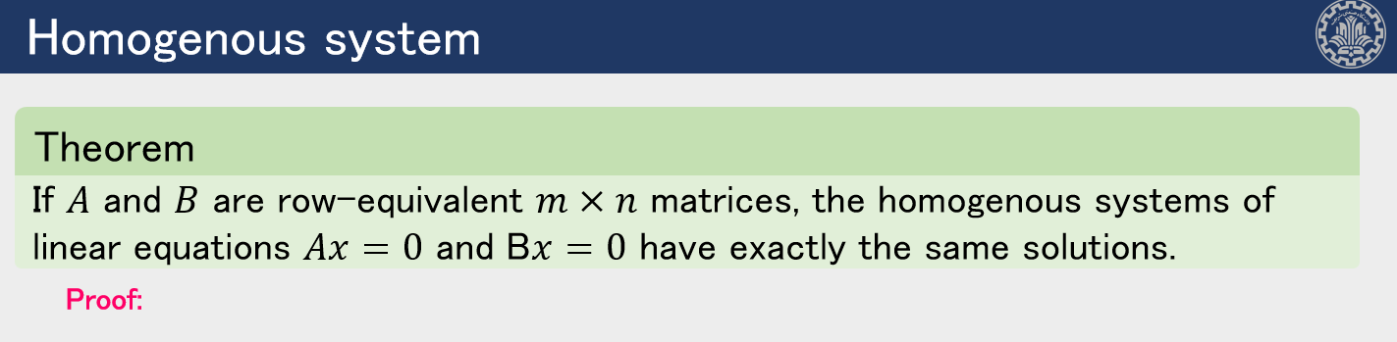
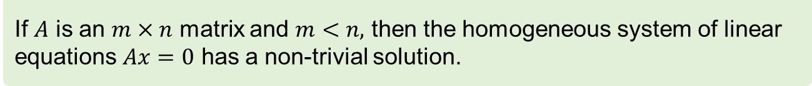
Existence Of Solutions
Theorem
If $A$ is an $m×n$ matrix and $m<n,$ then the homogeneous system of linear equations $Ax=0$ has a non-trivial solution.

Slide 24
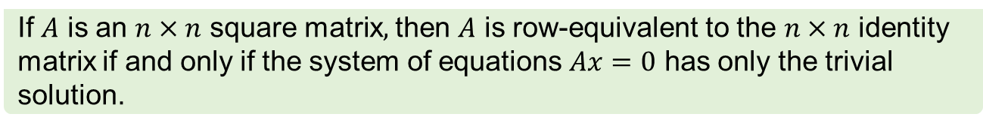
Existence Of Solutions
Theorem
If $A$ is an $n×n$ square matrix$,$ then $A$ is row-equivalent to the $n×n$ identity matrix if and only if the system of equations $Ax=0$ has only the trivial solution.

Slide 25
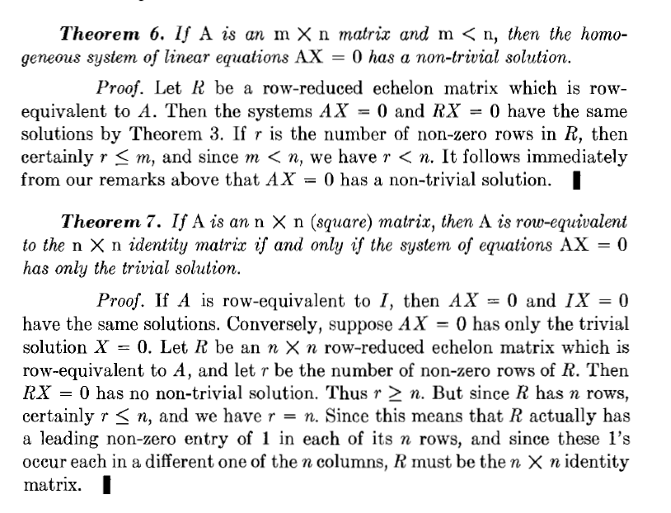

Slide 26
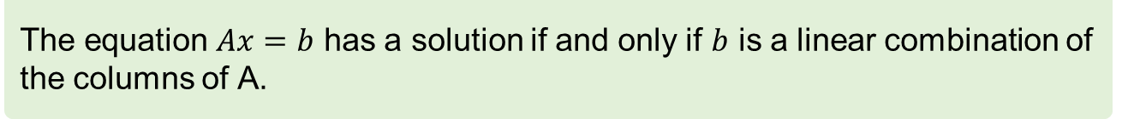
Existence Of Solutions
Fact
The equation $Ax=b$ has a solution if and only if $b$ is a linear combination of the columns of A.

Slide 27
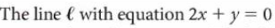
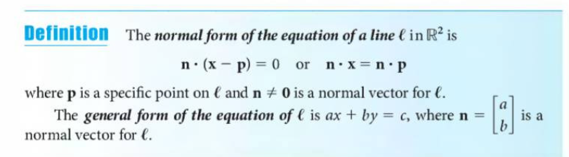
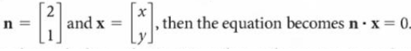
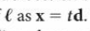
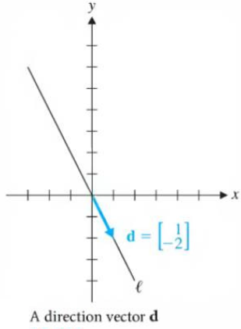
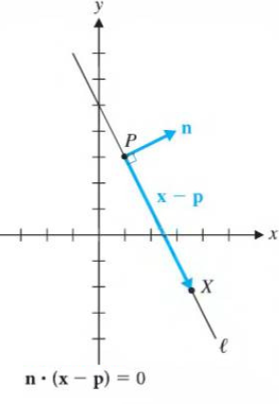
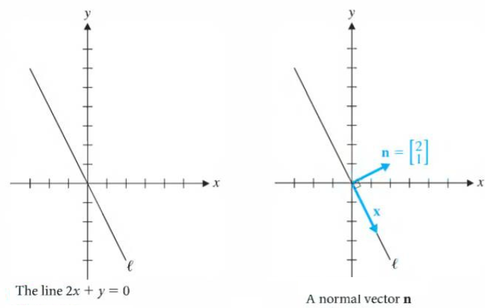
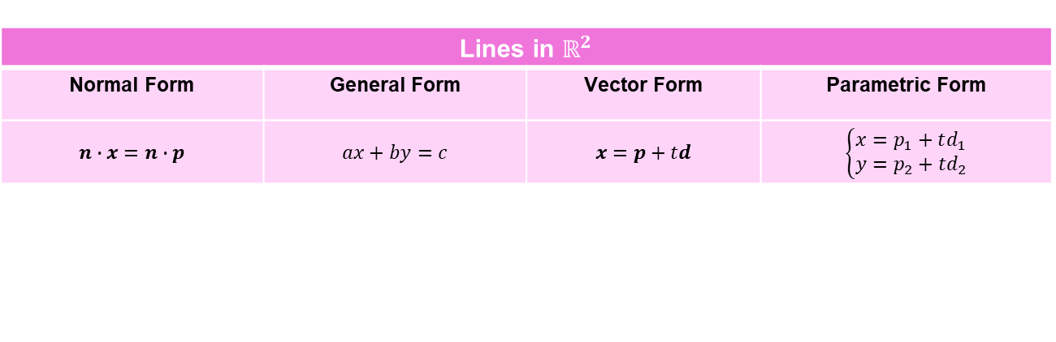
Line ($R^{2}$)
Lines in $ℝ^{2}$ | Equations of Lines in $ℝ^{2}$
Normal Form | General Form | Vector Form | Parametric Form
$$n∙x=n∙p$$ | $$ax+by=c$$ | $$x=p+td$$ | $$\left\{\begin{aligned}x=p_{1}+td_{1} \\ y=p_{2}+td_{2}\end{aligned}\right.$$
Notes:
n=[a,b] az normal form b general form miresim

Slide 28
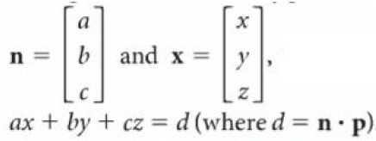
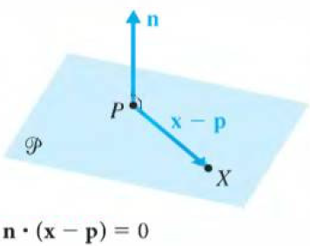
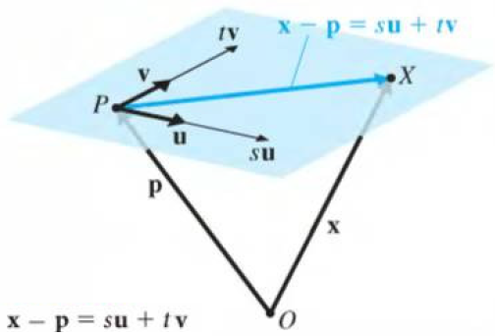
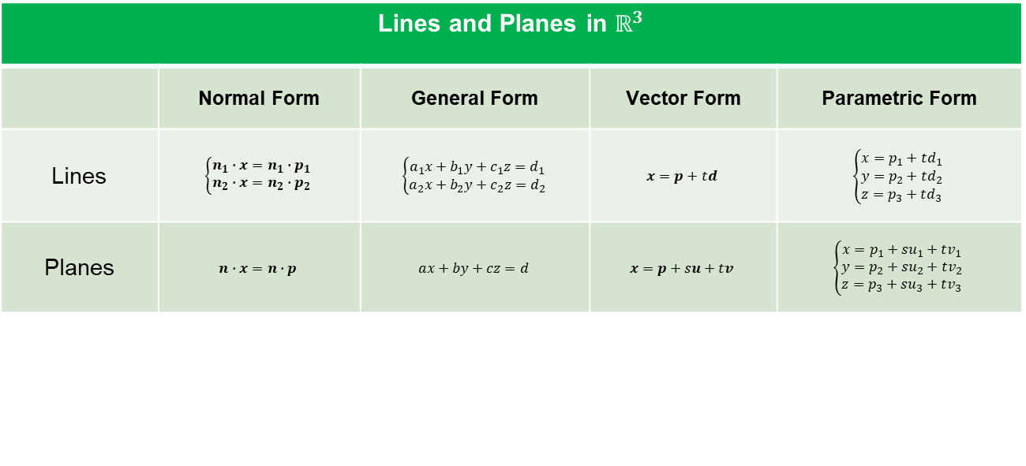
Plan ($R^{3}$)
Lines and Planes in $ℝ^{3}$ | Lines and Planes in $ℝ^{3}$
 | Normal Form | General Form | Vector Form | Parametric Form
Lines | $$\left\{\begin{aligned}n_{1}∙x=n_{1}∙p_{1} \\ n_{2}∙x=n_{2}∙p_{2}\end{aligned}\right.$$ | $$\left\{\begin{aligned}a_{1}x+b_{1}y+c_{1}z=d_{1} \\ a_{2}x+b_{2}y+c_{2}z=d_{2}\end{aligned}\right.$$ | $$x=p+td$$ | $$\left\{\begin{aligned}x=p_{1}+td_{1} \\ y=p_{2}+td_{2} \\ z=p_{3}+td_{3}\end{aligned}\right.$$
Planes | $$n∙x=n∙p$$ | $$ax+by+cz=d$$ | $$x=p+su+tv$$ | $$\left\{\begin{aligned}x=p_{1}+su_{1}+tv_{1} \\ y=p_{2}+su_{2}+tv_{2} \\ z=p_{3}+su_{3}+tv_{3}\end{aligned}\right.$$
Notes:
برای وکتور فرم: یک بردار توی صفحه از ترکیب خطی از دو تا بردار ساخته میشه

Slide 29
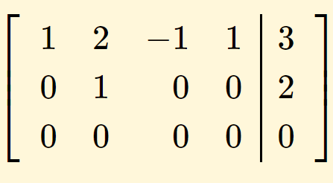
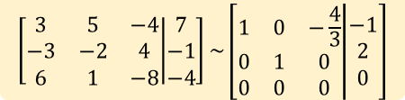
Nonhomogeneous Systems & General Solution
Example
Describe all solutions of $Ax=b$, where: $A= \left[\begin{matrix}3 & 5 & −4 \\ −3 & −2 & 4 \\ 6 & 1 & −8\end{matrix}\right]$ and $b= \left[\begin{matrix}7 \\ −1 \\ −4\end{matrix}\right]$
$$\left[\begin{matrix}3 & 5 & −4 \\ −3 & −2 & 4 \\ 6 & 1 & −8\end{matrix} | \begin{matrix}7 \\ −1 \\ −4\end{matrix}\right]\sim \left[\begin{matrix}1 & 0 & −\frac{4}{3} \\ 0 & 1 & 0 \\ 0 & 0 & 0\end{matrix} | \begin{matrix}−1 \\ 2 \\ 0\end{matrix}\right]$$
Example
Describe all solutions of $Ax=0$, where: $A= \left[\begin{matrix}1 & 0 & −8 & −7 \\ 0 & 1 & 4 & 3 \\ 0 & 0 & 0 & 0\end{matrix}\right]$.
Example
Describe all solutions of $Ax=b$, where: [$A b]= \left[\begin{matrix}1 & 2 & −1 & \begin{matrix}1 & 3\end{matrix} \\ 1 & 1 & −1 & \begin{matrix}1 & 1\end{matrix} \\ 1 & 3 & −1 & \begin{matrix}1 & 5\end{matrix}\end{matrix}\right]$.
Notes:
اگه بیشتر از یک free variable باشه معادله چطور میشه؟

Slide 30
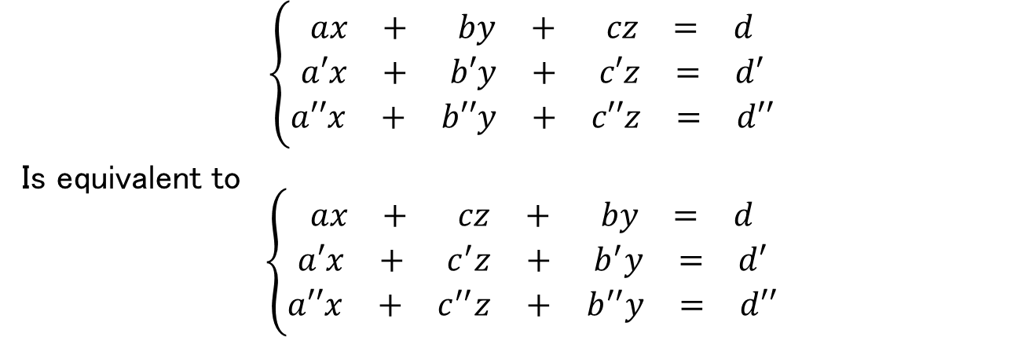
Nonhomogeneous Systems & General Solution
Question
Can we change the order of columns in an augmented matrix???
$$\left\{\begin{aligned}\begin{matrix}ax & + & by & + & cz & = & d\end{matrix} \\ \begin{matrix}a′x & + & b′y & + & c′z & = & d′\end{matrix} \\ \begin{matrix}a′′x & + & b′′y & + & c′′z & = & d′′\end{matrix}\end{aligned}\right.$$
Is equivalent to
$$\left\{\begin{aligned}\begin{matrix}ax & + & cz & + & by & = & d\end{matrix} \\ \begin{matrix}a′x & + & c^{′}z & + & b^{′}y & = & d′\end{matrix} \\ \begin{matrix}a′′x & + & c^{′′}z & + & b^{′′}y & = & d′′\end{matrix}\end{aligned}\right.$$

Slide 31
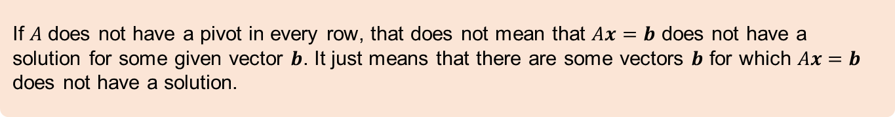
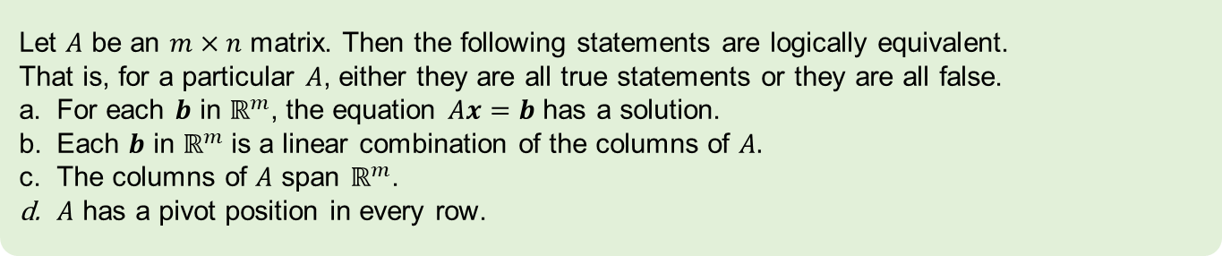
Conclusion
Theorem
Let $A$ be an $m×n$ matrix. Then the following statements are logically equivalent.
That is, for a particular $A$, either they are all true statements or they are all false.
For each $b$ in $ℝ^{m}$, the equation $Ax=b$ has a solution.
Each $b$ in $ℝ^{m}$ is a linear combination of the columns of $A.$
The columns of $A$ span $ℝ^{m}$.
$A$ has a pivot position in every row.
Note
If $A$ does not have a pivot in every row, that does not mean that $Ax=b$ does not have a solution for some given vector $b$. It just means that there are some vectors $b$ for which $Ax=b$ does not have a solution.

Slide 32
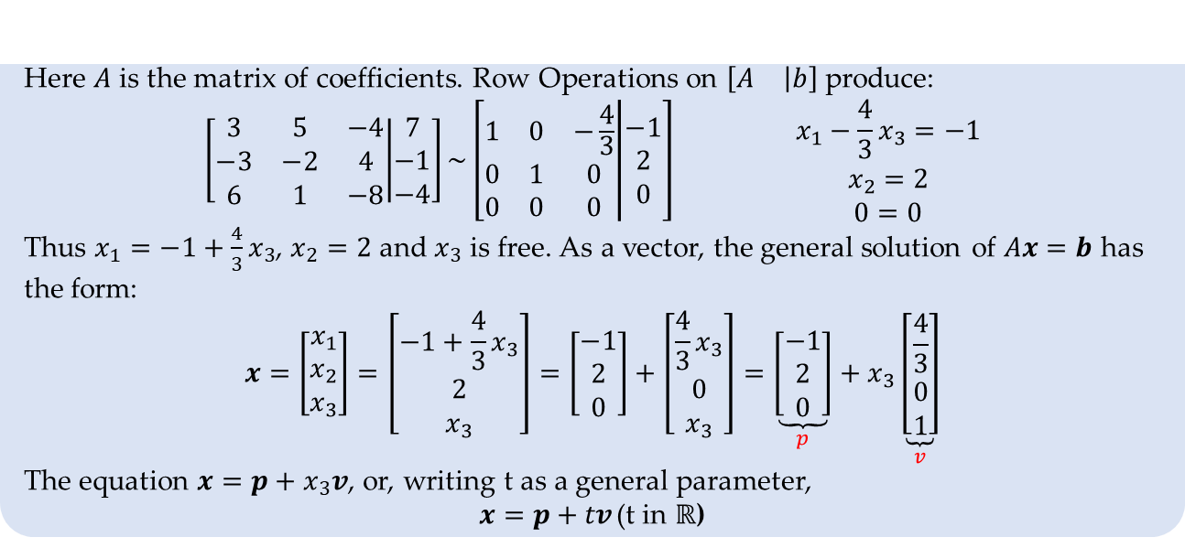
Nonhomogeneous Systems & General Solution
Example
Describe all solutions of $Ax=b$, where: $A= \left[\begin{matrix}3 & 5 & −4 \\ −3 & −2 & 4 \\ 6 & 1 & −8\end{matrix}\right]$ and $b= \left[\begin{matrix}7 \\ −1 \\ −4\end{matrix}\right]$
Here $A$ is the matrix of coefficients. Row Operations on $\left[\begin{matrix}A & \left|b\right.\end{matrix}\right]$ produce:
$$\begin{matrix}\left[\begin{matrix}3 & 5 & −4 \\ −3 & −2 & 4 \\ 6 & 1 & −8\end{matrix} | \begin{matrix}7 \\ −1 \\ −4\end{matrix}\right]\sim \left[\begin{matrix}1 & 0 & −\frac{4}{3} \\ 0 & 1 & 0 \\ 0 & 0 & 0\end{matrix} | \begin{matrix}−1 \\ 2 \\ 0\end{matrix}\right] & \begin{matrix}x_{1}−\frac{4}{3}x_{3}=−1 \\ x_{2}=2 \\ 0=0\end{matrix}\end{matrix}$$
Thus $x_{1}=−1+\frac{4}{3}x_{3}$, $x_{2}=2$ and $x_{3}$ is free. As a vector, the general solution of $Ax=b$ has the form:
$$x=\left[\begin{matrix}x_{1} \\ x_{2} \\ x_{3}\end{matrix}\right]=\left[\begin{matrix}−1+\frac{4}{3}x_{3} \\ 2 \\ x_{3}\end{matrix}\right]=\left[\begin{matrix}−1 \\ 2 \\ 0\end{matrix}\right]+\left[\begin{matrix}\frac{4}{3}x_{3} \\ 0 \\ x_{3}\end{matrix}\right]=\underset{p}{\underbrace{\left[\begin{matrix}−1 \\ 2 \\ 0\end{matrix}\right]}}+x_{3}\underset{v}{\underbrace{\left[\begin{matrix}\frac{4}{3} \\ 0 \\ 1\end{matrix}\right]}}$$
The equation $x=p+x_{3}v$, or, writing t as a general parameter,
$x=p+tv$ (t in $ℝ$)
General Solution written in vector form
Notes:
اگه بیشتر از یک free variable باشه معادله چطور میشه؟

Slide 33
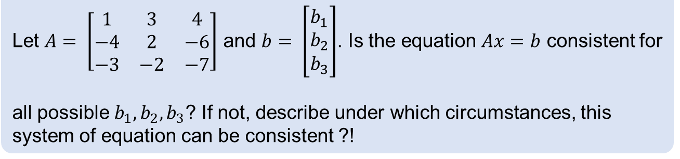
Existence of solutions
Example
Let $A= \left[\begin{matrix}1 & 3 & 4 \\ −4 & 2 & −6 \\ −3 & −2 & −7\end{matrix}\right]$ and $b= \left[\begin{matrix}b_{1} \\ b_{2} \\ b_{3}\end{matrix}\right]$. Is the equation $Ax=b$ consistent for
all possible $b_{1},b_{2},b_{3}$? If not, describe under which circumstances, this system of equation can be consistent ?!

Slide 34
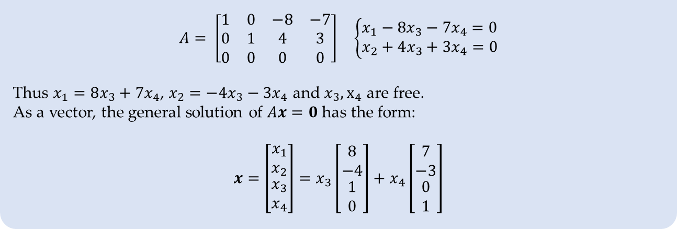
Nonhomogeneous Systems & General Solution
Example
Describe all solutions of $Ax=0$, where: $A= \left[\begin{matrix}1 & 0 & −8 & −7 \\ 0 & 1 & 4 & 3 \\ 0 & 0 & 0 & 0\end{matrix}\right]$.
$$\begin{matrix}A= \left[\begin{matrix}1 & 0 & −8 & −7 \\ 0 & 1 & 4 & 3 \\ 0 & 0 & 0 & 0\end{matrix}\right] & \left\{\begin{aligned}x_{1}−8x_{3}−7x_{4}=0 \\ x_{2}+4x_{3}+3x_{4}=0\end{aligned}\right.\end{matrix}$$
Thus $x_{1}=8x_{3}+7x_{4}$, $x_{2}=−4x_{3}−3x_{4}$ and $x_{3}, x_{4}$ are free.
As a vector, the general solution of $Ax=0$ has the form:
$$x=\left[\begin{matrix}x_{1} \\ x_{2} \\ \begin{aligned}x_{3} \\ x_{4}\end{aligned}\end{matrix}\right]=x_{3}\left[\begin{matrix}8 \\ −4 \\ \begin{aligned}1 \\ 0\end{aligned}\end{matrix}\right]+x_{4}\left[\begin{matrix}7 \\ −3 \\ \begin{aligned}0 \\ 1\end{aligned}\end{matrix}\right]$$
General Solution written in vector form
Notes:
اگه بیشتر از یک free variable باشه معادله چطور میشه؟

Slide 35
References
Chapter 1: Kenneth Hoffman and Ray A. Kunze. Linear Algebra. PHI Learning, 2004.
Chapter 1: David C. Lay, Steven R. Lay, and Judi J. McDonald. Linear Algebra and Its Applications. Pearson, 2016
Chapter 2: David Poole, Linear Algebra: A Modern Introduction. Cengage Learning, 2014.
Chaper1: Gilbert Strang. Introduction to Linear Algebra. Wellesley-Cambridge Press, 2016

Slide 36
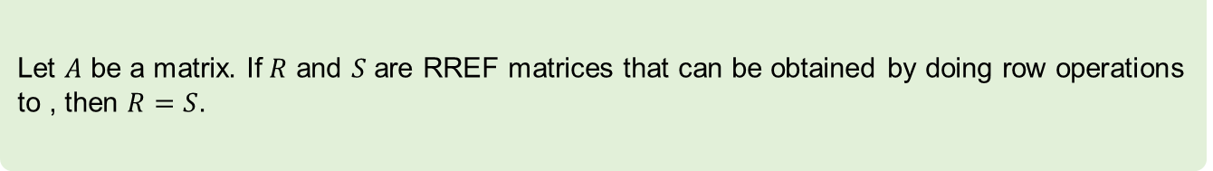
Reduced Echelon Form (RREF)
Theorem
For every matrix $A$, there is a sequence of row operations taking to a matrix $A$ in row reduced echelon form
Theorem
Let $A$ be a matrix. If $R$ and $S$ are RREF matrices that can be obtained by doing row operations
to , then $R=S$.

